Slide 1
Study on eCommerce behavior
Group member :Griffin, Adrian, Jackson, Zhixi Zhang

Slide 2

Catalogue
1
SECTION ONE
Introduction and simple visualization
2
SECTION TWO
Data preprocessing and algorithms applying.
3
SECTION THREE
Conclusion of results and application significance.

Slide 3
SECTION
ONE
This section presents the part of Introduction and simple visualization.

Slide 4



Why Study E-Commerce Consumer Behavior ?
Firstly, e-commerce has changed consumers’ expectations.
.
Secondly, shopping has become even more of a social activity.

Slide 5
SECTION ONE
Data set Introduction:
We chose a dataset that contains a user behavior data from a large eCommerce within 2 months(November and December of 2019). There are 9 properties in dataset: event-time, event- type, product-id, category-id, category-code, brand, price, user-id, user-session.

Slide 6
SECTION ONE
Thinking:
• When are people most likely to buy online?
• What can we get from study on consumer behavior?

Slide 7
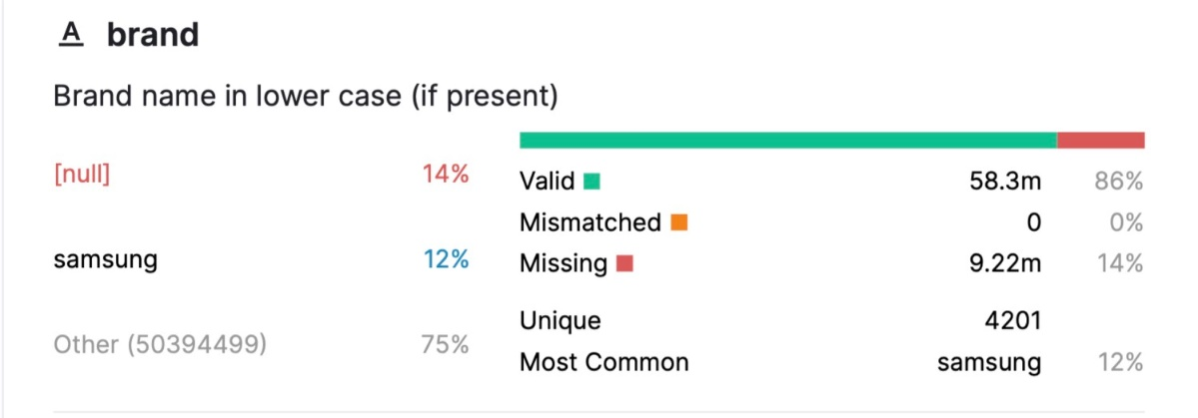
SECTION ONE
The first pie chart shows that only 2% of people will purchase the product.
Although the second pie chart shows that people shop online over an even period of time, people are most likely to buy in the afternoon.
As you can see the data on the bottom, the whole data set contains some irregular data and we will show in the part 2 that how we deal with it to make the whole project more applicable and more predictable.

Slide 8
SECTION
TWO
This section introduces how we operate the data preprocessing procedure and develop the relevant classification model for the datasets.

Slide 9
Section two
HUMANS ARE CREATIVE BEINGS. IF IT IS NOT REAL TEXT, THEY WILL FOCUS ON THE DESIGN.
1
Data preprocessing
 | Event time | Event type | Product id | Category_ id | Category_ code | Brand | Price | User id | User session
0 | 2019-11-01 00:00:00 UTC | view | 1003461 | 2053013555631882655 | electronics.smartphone | xiaomi | 489.07 | 520088904 | 4d3b30da-a5e4-49df-b1a8-ba5943f1dd33
1 | 2019-11-01 00:00:00 UTC | view | 5000088 | 2053013566100866035 | appliances.sewing_machine | janome | 293.65 | 530496790 | 8e5f4f83-366c-4f70-860e-ca7417414283
2 | 2019-11-01 00:00:01 UTC | view | 17302664 | 2053013553853497655 | NaN | creed | 28.31 | 561587266 | 755422e7-9040-477b-9bd2-6a6e8fd97387
········ | ... | ... | ... | ... | ... | ... | ... | ... | ...
42448761 | 2019-10-31 23:59:58 UTC | view | 5701038 | 2053013553970938175 | auto.accessories.player | kenwood | 128.70 | 566280422 | 05b6c62b-992f-4e8e-91f7-961bcb4719cd
42448762 | 2019-10-31 23:59:59 UTC | view | 21407424 | 2053013561579406073 | electronics.clocks | tissot | 689.85 | 513118352 | 4c14bf2a-2820-4504-929d-046356a5a204
42448763 | 2019-10-31 23:59:59 UTC | view | 13300120 | 2053013557166998015 | NaN | swisshome | 155.73 | 525266378 | 6e57d2d7-6022-46e6-81d6-fa77f14cef

Slide 10
Difficulties within row data
Event time | Event type | Product id | Category id | Category Code | Brand | Price | User id | User session
2019-11-13 20:38:32 UTC | view | 27700714 | 2053013560086233771 | construction.tools.pump | magnetta | 105.09 | 514828567 | 2dc7ccfb-4224-4ec1-9076-0d050606097c
2019-10-04 16:48:44 UTC | cart | 1004767 | 2053013555631882655 | electronics.smartphone | samsung | 252.63 | 512657465 | d6358e16-2186-4fd0-bb5c-2e644d0e064c
2019-11-26 03:45:24 UTC | view | 1005158 | 2053013555631882655 | NaN | xiaomi | 282.63 | 573260837 | aba54944-e843-48cf-87ec-80c2e9fe2ea9
109950743 rows × 9 columns
1
Data size
3
Nominal data
The database is too large and there is not enough space to hold intermediate data files.
Hard to fit in the data mining models.
Required to transform to numerical data.
2
Date data
4
Missing data
The form of the event time is not suitable for machine learning algorithms.
Values are missing due to several reasons.

Slide 11
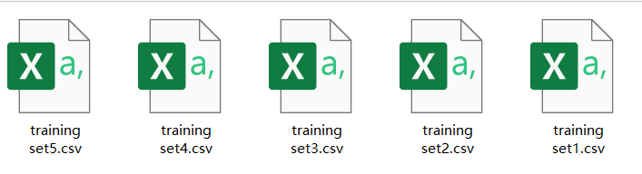


Data size Enormous amount of observations
1
5 times
train=df.sample(n=10000)
train.to_csv('training set.csv',index=0,sep=',')
Data extracting
In this part, we extract five random dataset within the size of 10000 and apply the same algorithms to see if the result is universal.
Processing capacity
Extract repeatedly
After extracting the database, we have the handling ability to the datasets.
We extract the data many times to ensure that the small dataset can represent the whole one.

Slide 12
Date data data in the form of time
2
Event time
2019-11-13 20:38:32 UTC
2019-10-04 16:48:44 UTC
2019-11-21 15:53:43 UTC
2019-11-26 03:45:24 UTC
2019-10-04 01:05:43 UTC
...
2019-11-15 11:30:59 UTC
2019-10-31 05:08:53 UTC
2019-10-15 13:20:20 UTC
2019-11-24 04:57:08 UTC
2019-11-14 05:10:41 UTC
Event time
20
16
15
03
01
...
11
05
13
04
05
Event time
evening
afternoon
afternoon
midnight
midnight
...
forenoon
midnight
afternoon
midnight
midnight
Data transforming
Sort out the date data into four groups in order to provide convenience for further study.

Slide 13
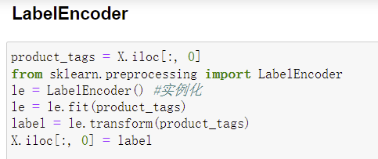
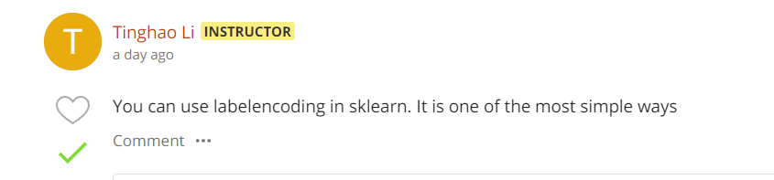
3
Nominal data data of vebal form
Coding dictionary
Event time
afternoon | 0
evening | 1
forenoon | 2
midnight | 3
Category id
accessories.bag | 0
accessories.umbrella | 1
accessories.wallet | 2
········· | 3
Category code
adidas | 0
amazon | 1
apple | 2
········· | 3

Slide 14

4
Missing data
“NaN” data
10000 rows × 9 columns
62.28%
Before deleting
1
2
After deleting
6228 rows × 9 columns
THE REMAINING DATA

Slide 15
Processed data
HUMANS ARE CREATIVE BEINGS. IF IT IS NOT REAL TEXT, THEY WILL FOCUS ON THE DESIGN.
 | Event time | Product id | Category id | Category code | Brand | Price | User id | User session | Event type
0 | 1 | 27700714 | 2053013560086233771 | 69 | 281 | 105.09 | 514828567 | 1120 | view
1 | 0 | 1004767 | 2053013555631882655 | 81 | 398 | 252.63 | 512657465 | 5199 | view
2 | 0 | 1005212 | 2053013555631882655 | 81 | 398 | 175.00 | 571496244 | 5657 | view
3 | 3 | 1005158 | 2053013555631882655 | 81 | 488 | 282.63 | 573260837 | 4163 | view
4 | 3 | 5100738 | 2053013553341792533 | 80 | 398 | 154.16 | 514605532 | 3282 | view

Slide 16
Processed data
HUMANS ARE CREATIVE BEINGS. IF IT IS NOT REAL TEXT, THEY WILL FOCUS ON THE DESIGN.
70%
30%
Training set
Test set

Slide 17
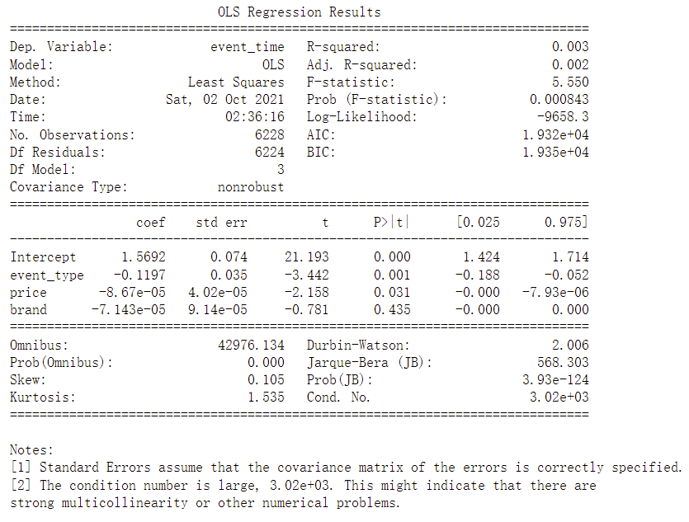
Multiple linear regression
HUMANS ARE CREATIVE BEINGS. IF IT IS NOT REAL TEXT, THEY WILL FOCUS ON THE DESIGN.
R^2
R-squared shows how well the data fit the regression model (the goodness of fit).
Multiple linear regression is not fit for this dataset.

Slide 18
Section two
"Data is what you need to do analytics. Information is what you need to do business." – John Owen
2
Developing data mining models
AlGORITHMS!
Linear Regression
Following pages would separately show the machine learning algorithms that we used in our models.
Random Forest
K-nearest neighbors(KNN)
Adaboost
Neutral Network

Slide 19

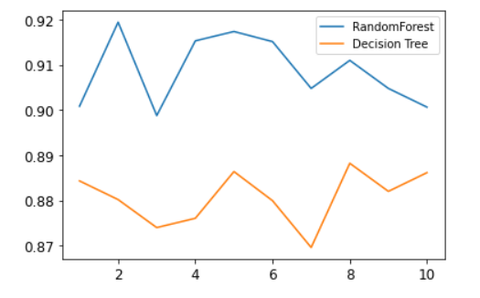
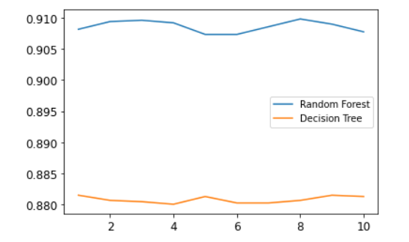
1
Random forest Ensemble learning method
The line charts of Random Forest versus Decision Tree
A Random Forest is essentially a collection of Decision Trees. A decision tree is built on an entire dataset, using all the features/variables of interest, whereas a random forest randomly selects observations/rows and specific features/variables to build multiple decision trees from and then averages the results.

Slide 20

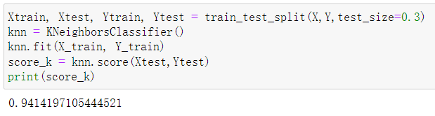

2
K-nearest neighbors(KNN) Non-parametric classification method
1
If k = 3 (solid line circle) it is assigned to the red triangles because there are 2 triangles and only 1 square inside the inner circle.
Example of k-NN classification.
2
If k = 5 (dashed line circle) it is assigned to the blue squares (3 squares vs. 2 triangles inside the outer circle).
The test sample (green dot) should be classified either to blue squares or to red triangles.
Performance in Modeling

Slide 21
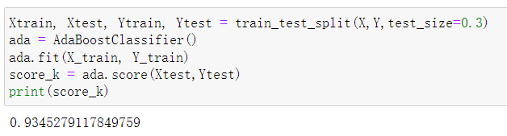
3
Adaboost Statistical Classification Meta-algorithm
→ The weak learners in AdaBoost are decision trees with a single split, called decision stumps.
→ AdaBoost works by putting more weight on difficult to classify instances and less on those already handled well.
→ AdaBoost algorithms can be used for both classification and regression problem.
AdaBoost is adaptive in the sense that subsequent weak learners are tweaked in favor of those instances misclassified by previous classifiers. The individual learners can be weak, but as long as the performance of each one is slightly better than random guessing, the final model can be proven to converge to a strong learner. In other words, it combine multiple “weak classifiers” into a single “strong classifier!
Performance in Modeling

Slide 22
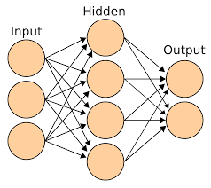
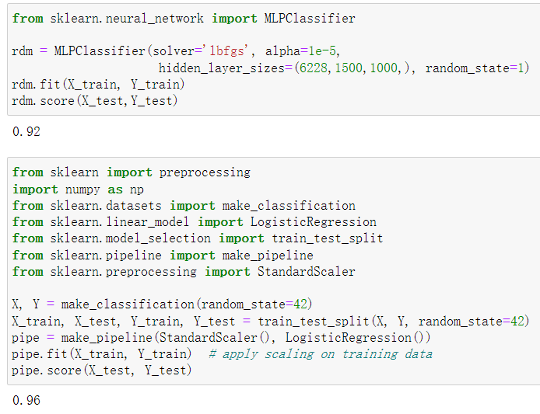
Netural Network Biological Neural Networks System
4
computing systems inspired by the biological neural networks that constitute animal brains
Depth
Layer
Complexity
Supervised learning
Performance in Modeling

Slide 23
CHAPTER
THREE
Model Selection& Project Significance

Slide 24
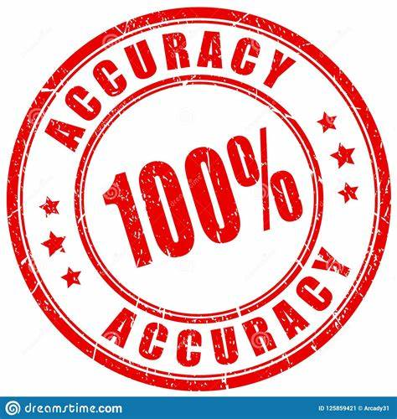

Accuracy Comparison
All the accuracy is the average accuracy value of the five datasets.
Random Forest
91%
Linear Regression
0%
ADA Boost
94%
Neural Network
92%
KNN
95%
KNN is to be the selected model of this project.

Slide 25





REPLY
Afternoon
judge the potential tendency of users
improve the product information service

Slide 26

SIGNIFICANCE
IDENTIFYING CONSUMER PAIN POINTS
OPTIMIZING MARKETING EFFORTS
Most Importantly
consumer behavior analysis helps us understand what consumers think and feel about a brand, what influences them to choose one over the other, why and how they shop, and how their environment influences their behavior.
CBA
IMPROVE PRODUCT INNOVATION
IMPROVE BRAND INNOVATION

Slide 27
Thank You!

